Slide 1

Overcoming Adversaries

Slide 2
Announcements
Small change to PS1. Assume no one way roads.
Online office hours. More office hours.
Markov Decision Problem handout.
Probability review this Friday.
4th of July on Thursday.
Snowden still in Russian airport.

Slide 3
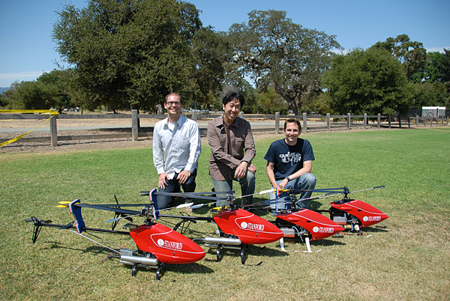
http://youtu.be/kN6ifrqwIMY

Slide 4
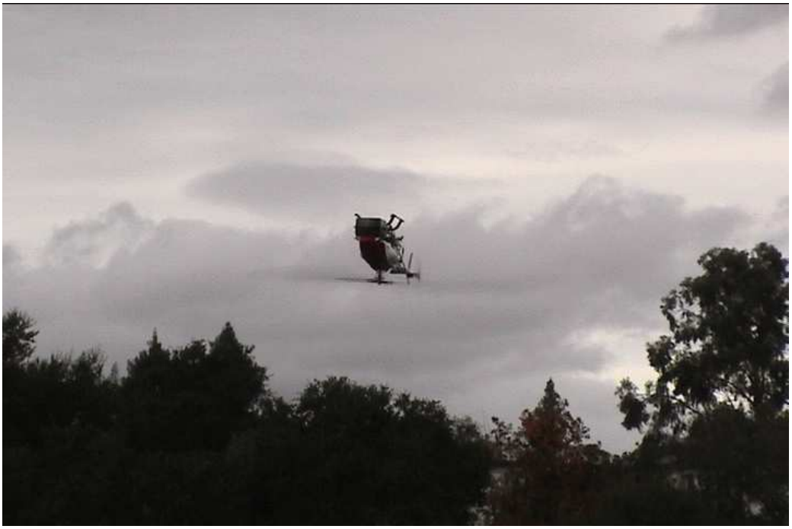
THE Hardest Control Problem

Slide 5
How does it work?

Slide 6
[suspense]

Slide 7
A Teaser for End of Lecture

Slide 8
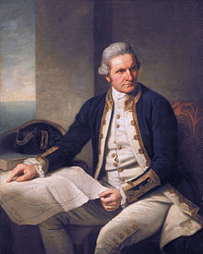
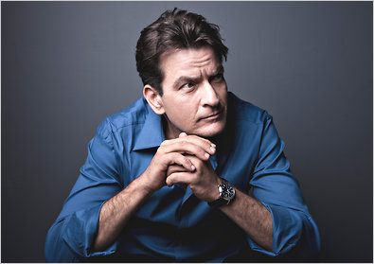
1770
Notes:
Charlie Sheen

Slide 9
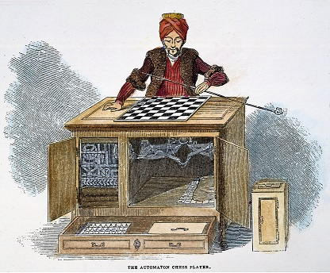
History of Chess
1770
Hapsburg
Empire

Slide 10

1997

Slide 11
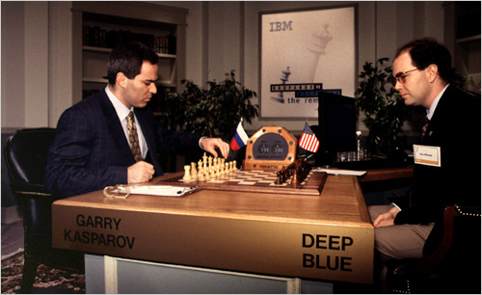
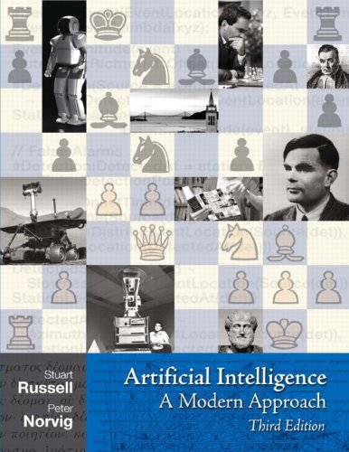
Deep Blue

Slide 12

What’s in a name?

Slide 13
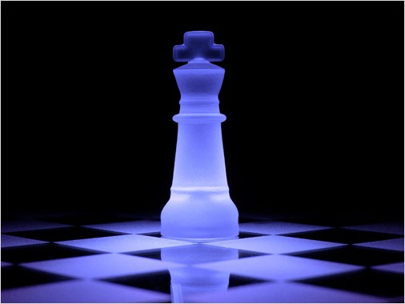
How Does it Work?

Slide 14

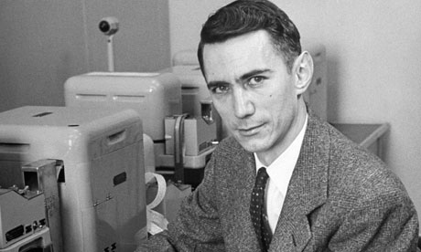
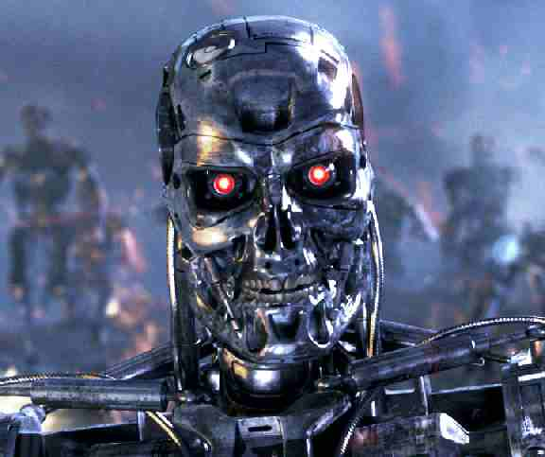
First Steps
Notes:
Josh Hartnet

Slide 15
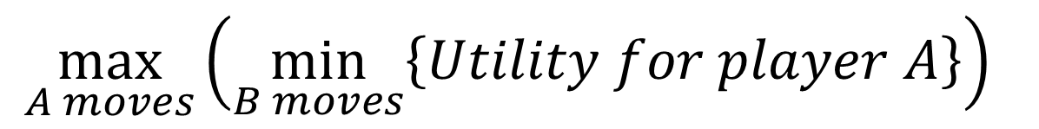
The Best of the Worst
Assume rational opponent:
Ie your opponent will take the best
move possible from their Perspective.

Slide 16
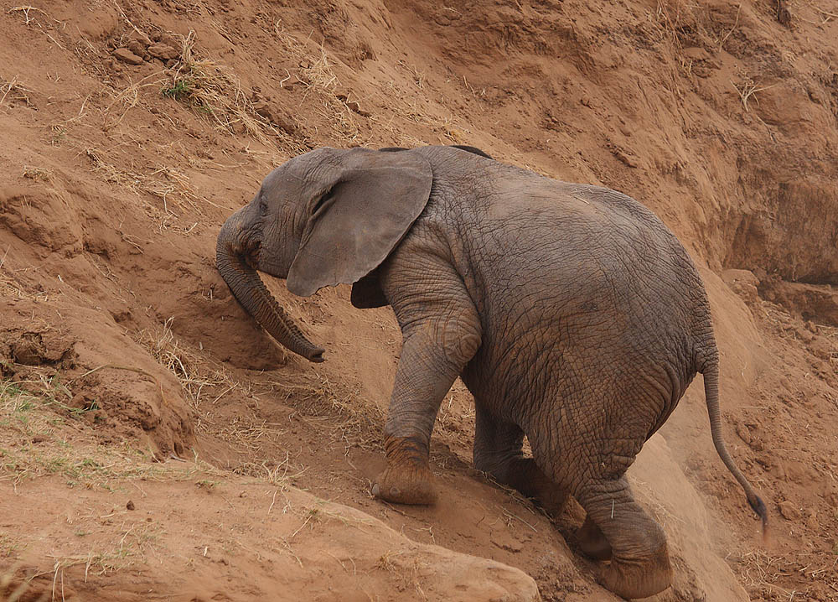
Adversarial Games

Slide 17

Adversarial Search
Alpha Beta
Search Overview

Slide 18
Adversarial Search
Alpha Beta
Search Overview

Slide 19
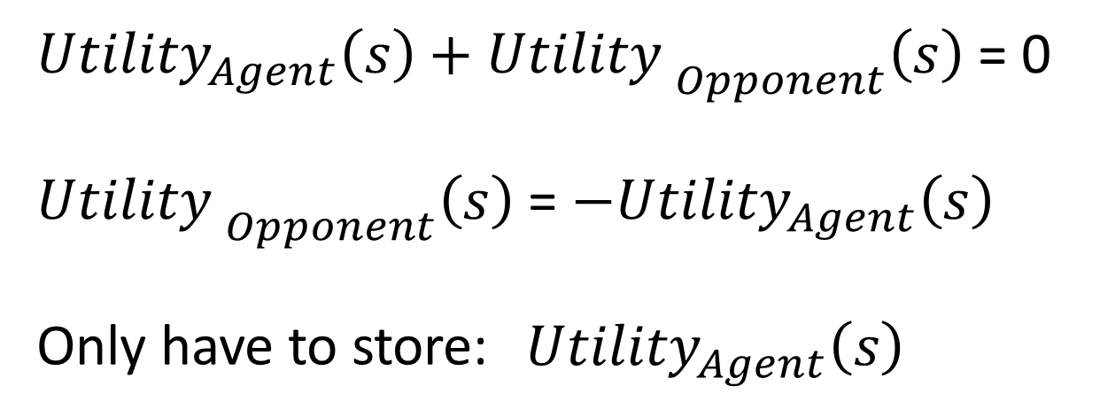
Zero Sum Game

Slide 20
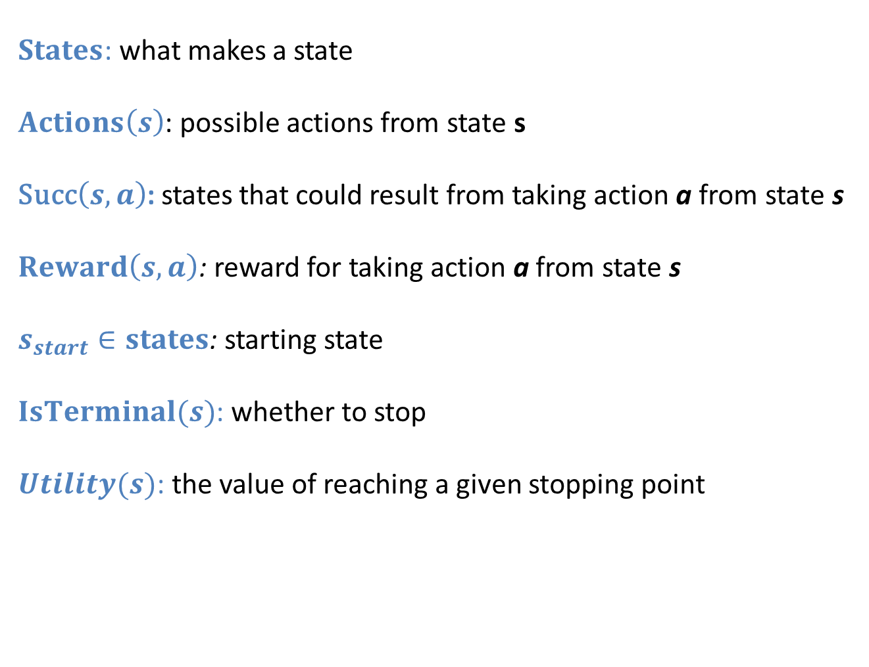
Modeling Discrete Search
$States$: what makes a state
$Actions\left(s\right)$: possible actions from state s
Succ$\left(s, a\right)$: states that could result from taking action a from state s
$Reward\left(s, a\right)$: reward for taking action a from state s
$s_{start}∈states$: starting state
$IsTerminal(s)$: whether to stop
$Utility(s)$: the value of reaching a given stopping point

Slide 21
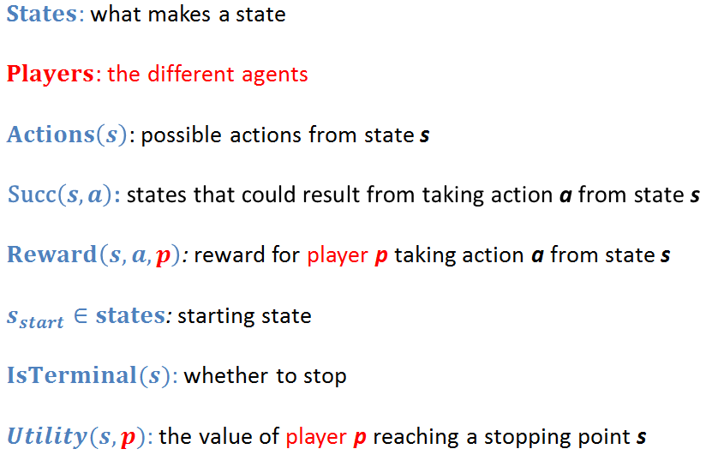
Modeling Adversarial Decision

Slide 22

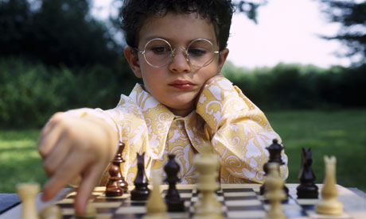
MDP vs Adversarial
Vs Nature
Vs Adversary

Slide 23
MDP vs Adversarial
3
6
3
6
8
5
4
9
2
1
8
8
5
4
9
2
1
8
Markov Decision Process
Adversarial

Slide 24
MDP vs Adversarial
probabilities
3
6
3
6
8
5
4
9
2
1
8
8
5
4
9
2
1
8
Markov Decision Process
Adversarial

Slide 25
MDP vs Adversarial
minimizer
probabilities
3
6
3
6
8
5
4
9
2
1
8
8
5
4
9
2
1
8
Markov Decision Process
Adversarial

Slide 26
Minimax vs Expectimax
3
6
3
6
8
5
4
9
2
1
8
8
5
4
9
2
1
8
Expectimax
Minimax

Slide 27
Minimax vs Expectimax
3
6
3
6
8
5
4
9
2
1
8
8
5
4
9
2
1
8
Terminals
Terminals

Slide 28
Minimax vs Expectimax
3
6
3
6
8
5
4
9
2
1
8
8
5
4
9
2
1
8
Maximize
Maximize

Slide 29
Minimax vs Expectimax
3
6
3
6
8
5
4
9
2
1
8
8
5
4
9
2
1
8
Expectation
Minimize

Slide 30
Minimax vs Expectimax
3
6
3
6
8
5
4
9
2
1
8
8
5
4
9
2
1
8
Maximize
Maximize

Slide 31
Ply
3
6
3
6
8
5
4
9
2
1
8
8
5
4
9
2
1
8

Slide 32
Minimax vs Expectimax
Alternating rows of
expectation (nature) and
maximizing (player)
Alternating rows of
minimizing (adversary)
and maximizing (player)
Expectimax
Minimax

Slide 33
Minimax vs Expectimax
Alternating rows of
expectation (nature) and
maximizing (player)
Alternating rows of
minimizing (adversary)
and maximizing (player)
Expectimax
Minimax

Slide 34
Minimax vs Expectimax
Alternating rows of
expectation (nature) and
maximizing (player)
Alternating rows of
minimizing (adversary)
and maximizing (player)
Expectimax
Minimax

Slide 35
Minimax
3
6
8
5
4
9
2
1
8

Slide 36
Minimax
3
6
8
5
4
9
2
Terminals
1
8

Slide 37
Minimax
Max
3
6
8
5
4
9
2
1
8

Slide 38
Minimax
Max
8
3
6
8
5
4
9
2
1
8

Slide 39
Minimax
Max
8
3
4
6
8
5
4
9
2
1
8

Slide 40
Minimax
Max
8
3
4
9
6
8
5
4
9
2
1
8

Slide 41
Minimax
Max
8
3
4
9
6
1
8
5
4
9
2
1
8

Slide 42
Minimax
Max
8
3
4
9
6
1
8
8
5
4
9
2
1
8

Slide 43
Minimax
Min
8
3
4
9
6
1
8
8
5
4
9
2
1
8

Slide 44
Minimax
Min
3
8
3
4
9
6
1
8
8
5
4
9
2
1
8

Slide 45
Minimax
Min
3
6
8
3
4
9
6
1
8
8
5
4
9
2
1
8

Slide 46
Minimax
Min
3
6
1
8
3
4
9
6
1
8
8
5
4
9
2
1
8

Slide 47
Minimax
Max
3
6
1
8
3
4
9
6
1
8
8
5
4
9
2
1
8

Slide 48
Minimax
6
Max
3
6
1
8
3
4
9
6
1
8
8
5
4
9
2
1
8

Slide 49
Minimax
6
Chosen Action
3
6
1
8
3
4
9
6
1
8
8
5
4
9
2
1
8

Slide 50
Minimax
6
Chosen Action
3
6
1
Assumed
Reaction
8
3
4
9
6
1
8
8
5
4
9
2
1
8

Slide 51
Minimax
def miniMax(node, depth, isMax):
if node.isTerminal():
return node.getScore()
if depth == 0:
return node.getHeuristicScore()
actionValues = []
for action in node.getLegalActions():
child = node.getSuccessorState(action)
value = miniMax(child, depth -1, not isMax)
actionValues.append(value)
if isMax: return max(actionValues)
return min(actionValues)

Slide 52
Minimax
def miniMax(node, depth, isMax):
if node.isTerminal():
return node.getScore()
if depth == 0:
return node.getHeuristicScore()
actionValues = []
for action in node.getLegalActions():
child = node.getSuccessorState(action)
value = miniMax(child, depth -1, not isMax)
actionValues.append(value)
if isMax: return max(actionValues)
return min(actionValues)

Slide 53
Minimax
def miniMax(node, depth, isMax):
if node.isTerminal():
return node.getScore()
if depth == 0:
return node.getHeuristicScore()
actionValues = []
for action in node.getLegalActions():
child = node.getSuccessorState(action)
value = miniMax(child, depth -1, not isMax)
actionValues.append(value)
if isMax: return max(actionValues)
return min(actionValues)

Slide 54
Minimax
def miniMax(node, depth, isMax):
if node.isTerminal():
return node.getScore()
if depth == 0:
return node.getHeuristicScore()
actionValues = []
for action in node.getLegalActions():
child = node.getSuccessorState(action)
value = miniMax(child, depth -1, not isMax)
actionValues.append(value)
if isMax: return max(actionValues)
return min(actionValues)

Slide 55
Minimax
def miniMax(node, depth, isMax):
if node.isTerminal():
return node.getScore()
if depth == 0:
return node.getHeuristicScore()
actionValues = []
for action in node.getLegalActions():
child = node.getSuccessorState(action)
value = miniMax(child, depth -1, not isMax)
actionValues.append(value)
if isMax: return max(actionValues)
return min(actionValues)

Slide 56
Minimax
def miniMax(node, depth, isMax):
if node.isTerminal():
return node.getScore()
if depth == 0:
return node.getHeuristicScore()
actionValues = []
for action in node.getLegalActions():
child = node.getSuccessorState(action)
value = miniMax(child, depth -1, not isMax)
actionValues.append(value)
if isMax: return max(actionValues)
return min(actionValues)

Slide 57
Minimax
def miniMax(node, depth, isMax):
if node.isTerminal():
return node.getScore()
if depth == 0:
return node.getHeuristicScore()
actionValues = []
for action in node.getLegalActions():
child = node.getSuccessorState(action)
value = miniMax(child, depth -1, not isMax)
actionValues.append(value)
if isMax: return max(actionValues)
return min(actionValues)

Slide 58
Minimax
def miniMax(node, depth, isMax):
if node.isTerminal():
return node.getScore()
if depth == 0:
return node.getHeuristicScore()
actionValues = []
for action in node.getLegalActions():
child = node.getSuccessorState(action)
value = miniMax(child, depth -1, not isMax)
actionValues.append(value)
if isMax: return max(actionValues)
return min(actionValues)

Slide 59
Minimax
def miniMax(node, depth, isMax):
if node.isTerminal():
return node.getScore()
if depth == 0:
return node.getHeuristicScore()
actionValues = []
for action in node.getLegalActions():
child = node.getSuccessorState(action)
value = miniMax(child, depth -1, not isMax)
actionValues.append(value)
if isMax: return max(actionValues)
return min(actionValues)

Slide 60
Minimax
def miniMax(node, depth, isMax):
if node.isTerminal():
return node.getScore()
if depth == 0:
return node.getHeuristicScore()
actionValues = []
for action in node.getLegalActions():
child = node.getSuccessorState(action)
value = miniMax(child, depth -1, not isMax)
actionValues.append(value)
if isMax: return max(actionValues)
return min(actionValues)

Slide 61
Minimax
def miniMax(node, depth, isMax):
if node.isTerminal():
return node.getScore()
if depth == 0:
return node.getHeuristicScore()
actionValues = []
for action in node.getLegalActions():
child = node.getSuccessorState(action)
value = miniMax(child, depth -1, not isMax)
actionValues.append(value)
if isMax: return max(actionValues)
return min(actionValues)

Slide 62
Is this Depth First or Breadth First?
def miniMax(node, depth, isMax):
if node.isTerminal():
return node.getScore()
if depth == 0:
return node.getHeuristicScore()
actionValues = []
for action in node.getLegalActions():
child = node.getSuccessorState(action)
value = miniMax(child, depth -1, not isMax)
actionValues.append(value)
if isMax: return max(actionValues)
return min(actionValues)

Slide 63
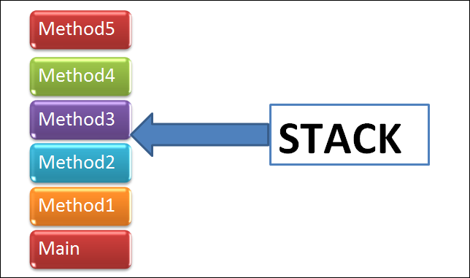
Where is the stack?

Slide 64
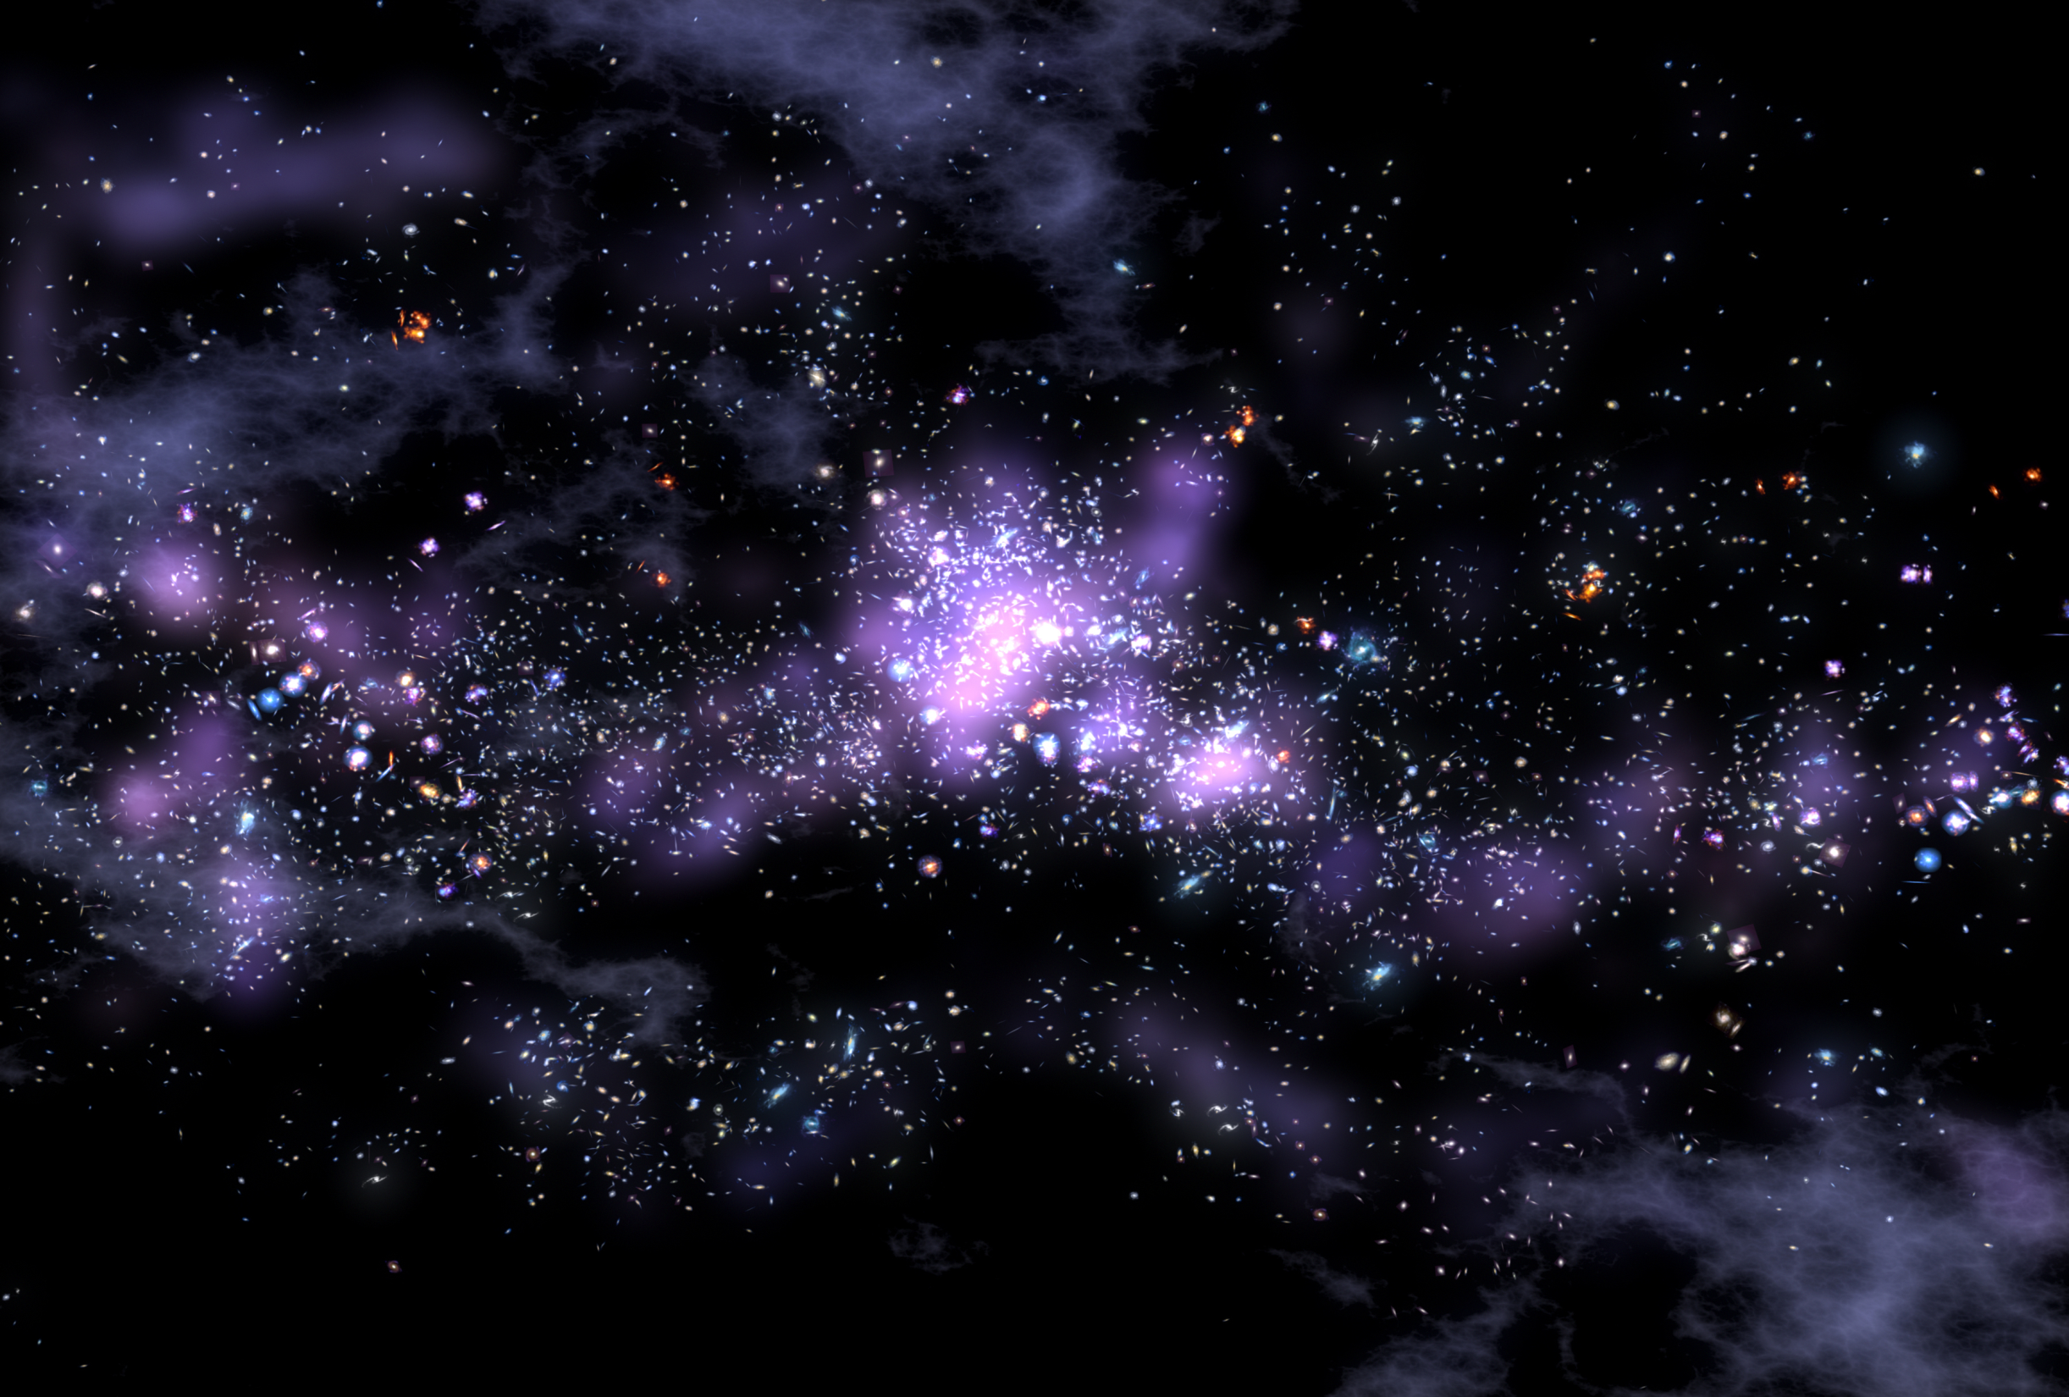
Chess is kind of big…

Slide 65

Heuristics

Slide 66
Chess is still kind of big…

Slide 67
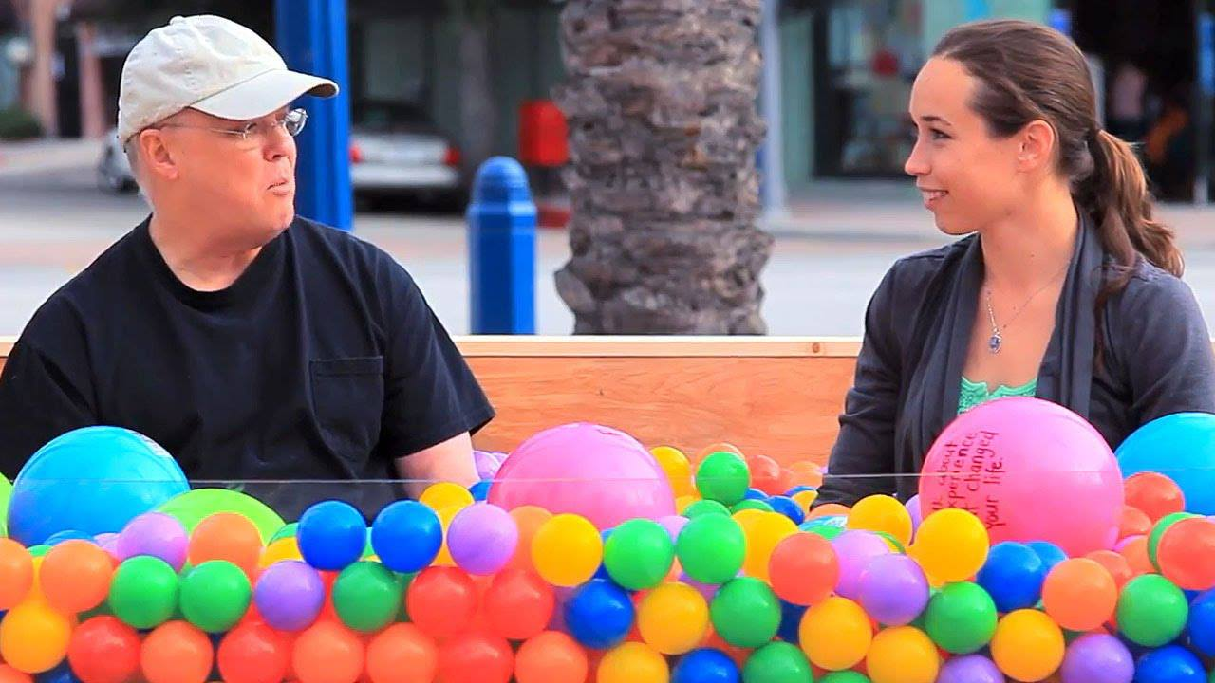
http://www.youtube.com/watch?v=HfHV4-N2LxQ

Slide 68
Chess is still kind of big…

Slide 69
Adversarial Search
Alpha Beta
Search Overview

Slide 70
Adversarial Search
Alpha Beta
Search Overview

Slide 71
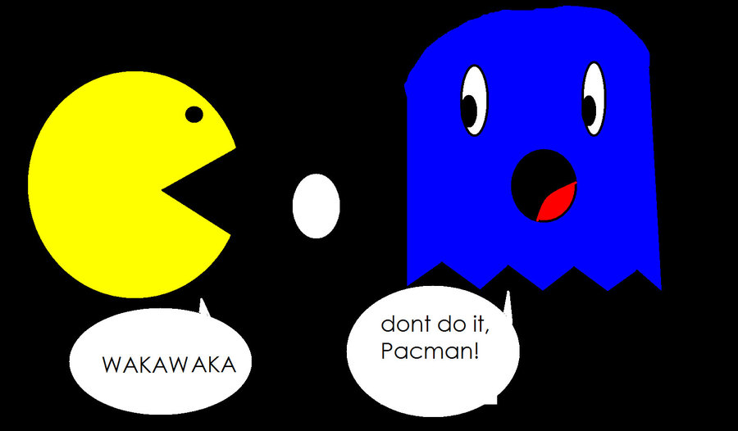
Alpha Beta Pruning

Slide 72

Pruning Intuition

Slide 73
Formally
α: largest value so far along path for player max; used to prune min states
β: smallest value so far along path for player min; used to prune max states

Slide 74
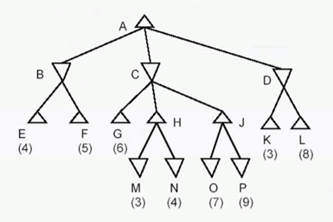
Alpha Beta Pruning

Slide 75
Minimax
def miniMax(node, depth, isMax):
if node.isTerminal():
return node.getScore()
if depth == 0:
return node.getHeuristicScore()
actionValues = []
for action in node.getLegalActions():
child = node.getSuccessorState(action)
value = miniMax(child, depth -1, not isMax)
actionValues.append(value)
if isMax: return max(actionValues)
return min(actionValues)

Slide 76
Alpha Beta Pruning
def miniMax(self, node, depth, alpha, beta, isMax):
if node.isTerminal():
if isMax return node.utility()
return –node.utility()
if depth == 0:
return self.getHeuristic(node)
if isMax:
for action in node.getLegalActions():
child = node.getSuccessorState(action)
value = miniMax(child, depth -1, alpha, beta, not isMax)
alpha = max(alpha, value)
if beta <= alpha: break
return alpha
else:
for action in node.getLegalActions():
child = node.getSuccessorState(action)
value = self.miniMax(child, depth -1, alpha, beta, not isMax)
beta = min(value, beta)
if beta <= alpha: break
return beta

Slide 77
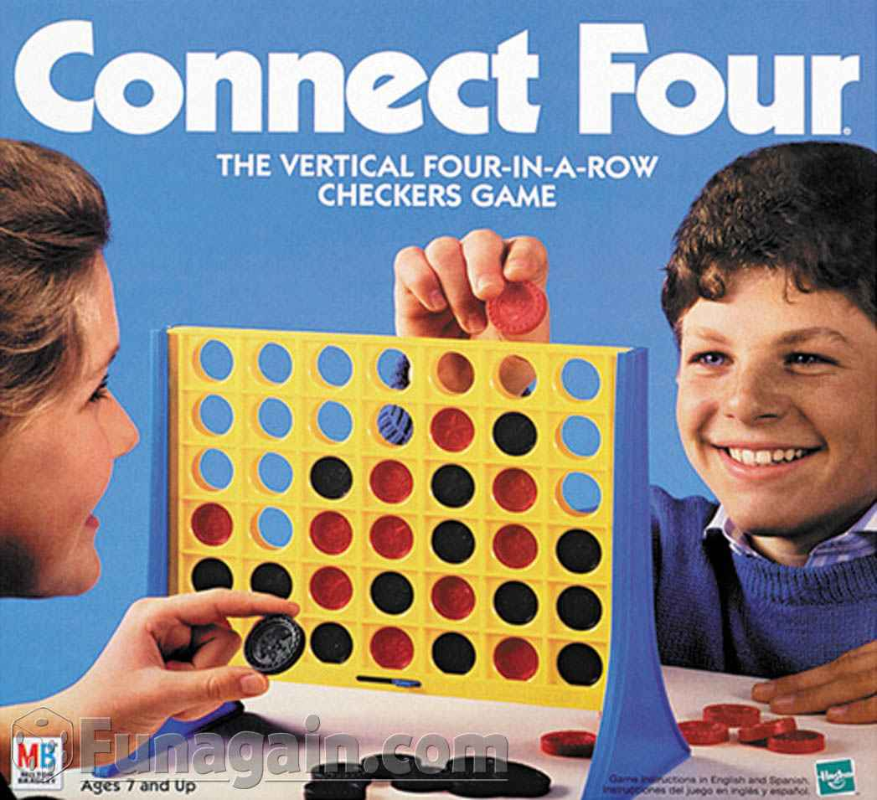

Slide 78
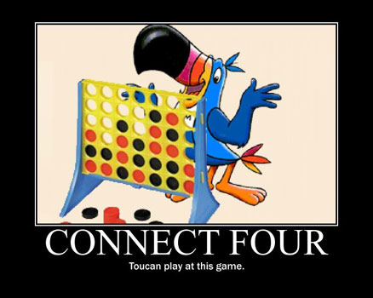

Slide 79
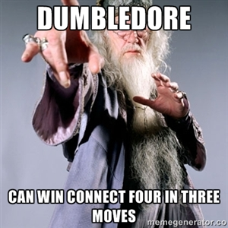

Slide 80
cs221.stanford.edu/handouts/minimax.html

Slide 81
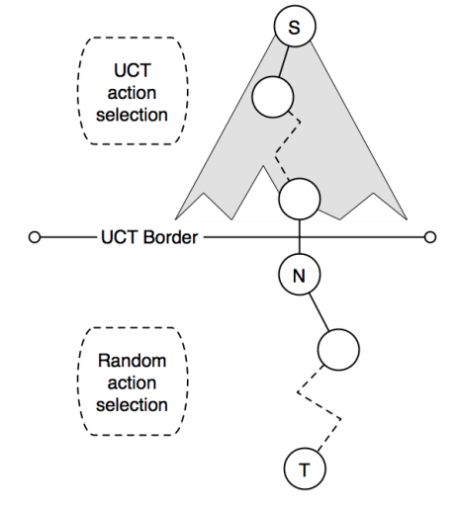
Depth Charges

Slide 82

Other Adversarial Games

Slide 83

Other Adversarial Games

Slide 84
How Does it Work?

Slide 85
How Does it Work?
500 processors designed to find moves in chess
Opening book of 4,000 states
Record of 70,000 grand master games, from which they made a pretty decent heuristic
Transposition tables to find symmetry
Alpha Beta Minimax
Averaged 30 billion states, depth of 14

Slide 87

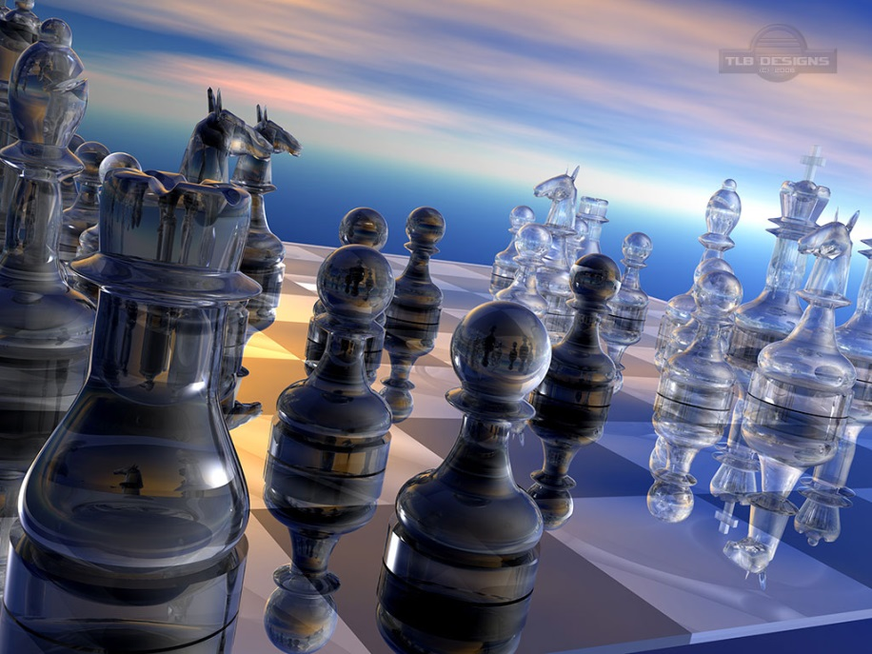

What do these things have in common
ATTGGGAAATGCCCCATTATTBBC
ATTGGAATCGACATATTATTBBC

Slide 88
Adversarial Search
Alpha Beta
Search Overview

Slide 89
Adversarial Search
Alpha Beta
Search Overview

Slide 90



Search Overview
Deterministic Search
Vs Self
Markov Decisions
Vs Nature
Adversarial Search
Vs Opponent

Slide 91
The AI Pipeline
Real World Problem
Model the problem
Formal Problem
Apply an Algorithm
Evaluate
Solution

Slide 92
The AI Pipeline
Real World Problem
Model the problem
Formal Problem
Apply an Algorithm
Evaluate
Solution

Slide 93

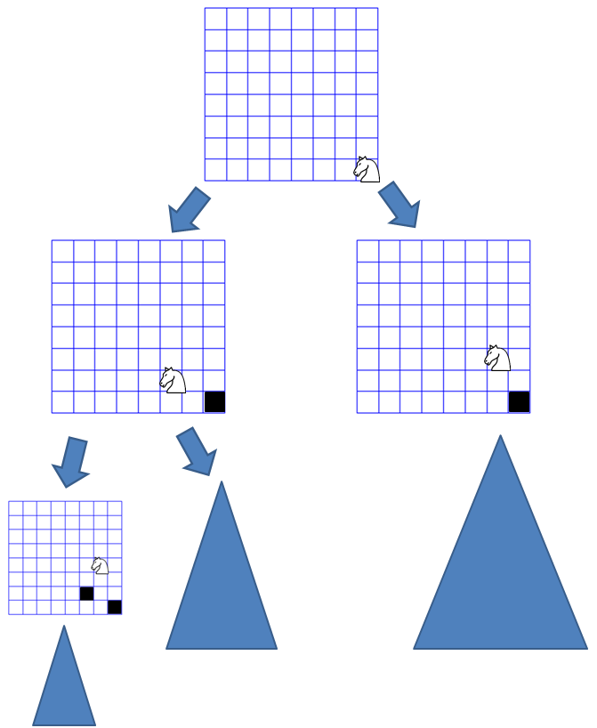
Formalization
Deterministic Search Problems

Slide 94

Uses
World is discrete states
Current state is known
Actions are known
Successors are known

Slide 95
Formalization

Slide 96
Algorithms
Algorithm | Uses | Downsides | To Know
DFS | Low memory | Non optimal | Implement
BFS | Optimal for uniform cost | Slow | Implement
UCS (Dijkstra) | Optimal for positive cost | Slow | Implement
A* | Optimal for positive cost | Think of heuristic | Implement (and create)
Bellman - Ford | Optimal for any cost | Slower than UCS | Know

Slide 97
Algorithms
Algorithm | Uses | Downsides | To Know
DFS | Low memory | Non optimal | Implement
BFS | Optimal for uniform cost | Slow | Implement
UCS (Dijkstra) | Optimal for positive cost | Slow | Implement
A* | Optimal for positive cost | Think of heuristic | Implement (and create)
Bellman - Ford | Optimal for any cost | Slower than UCS | Know

Slide 98
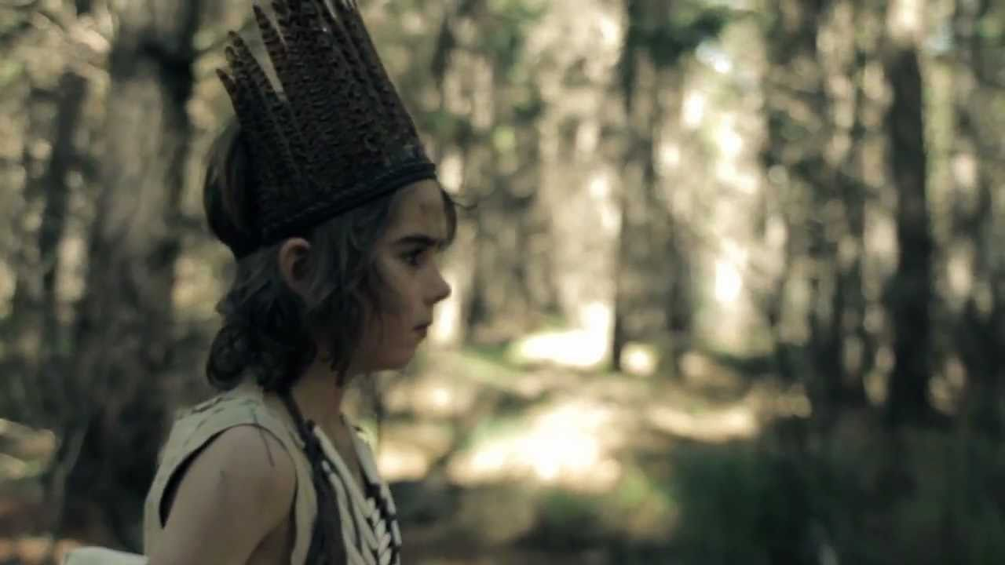
Markov Decision Problems

Slide 99
Uses
World is discrete states
Current state is known
Actions are known
Successors are (markov) probability distributions
Finite Horizon

Slide 100
Formalization
Hong Kong
Fly to Moscow
Fly to US
US
Moscow
US

Slide 101
Algorithms
probabilities
3
6
8
5
4
9
2
1
8

Slide 102

Algorithms

Slide 103
Adversarial Search Problems

Slide 104
Uses
World is discrete states
Current state is known
Actions are known
Successors are known
Other adversarial agents
Finite Horizon

Slide 105
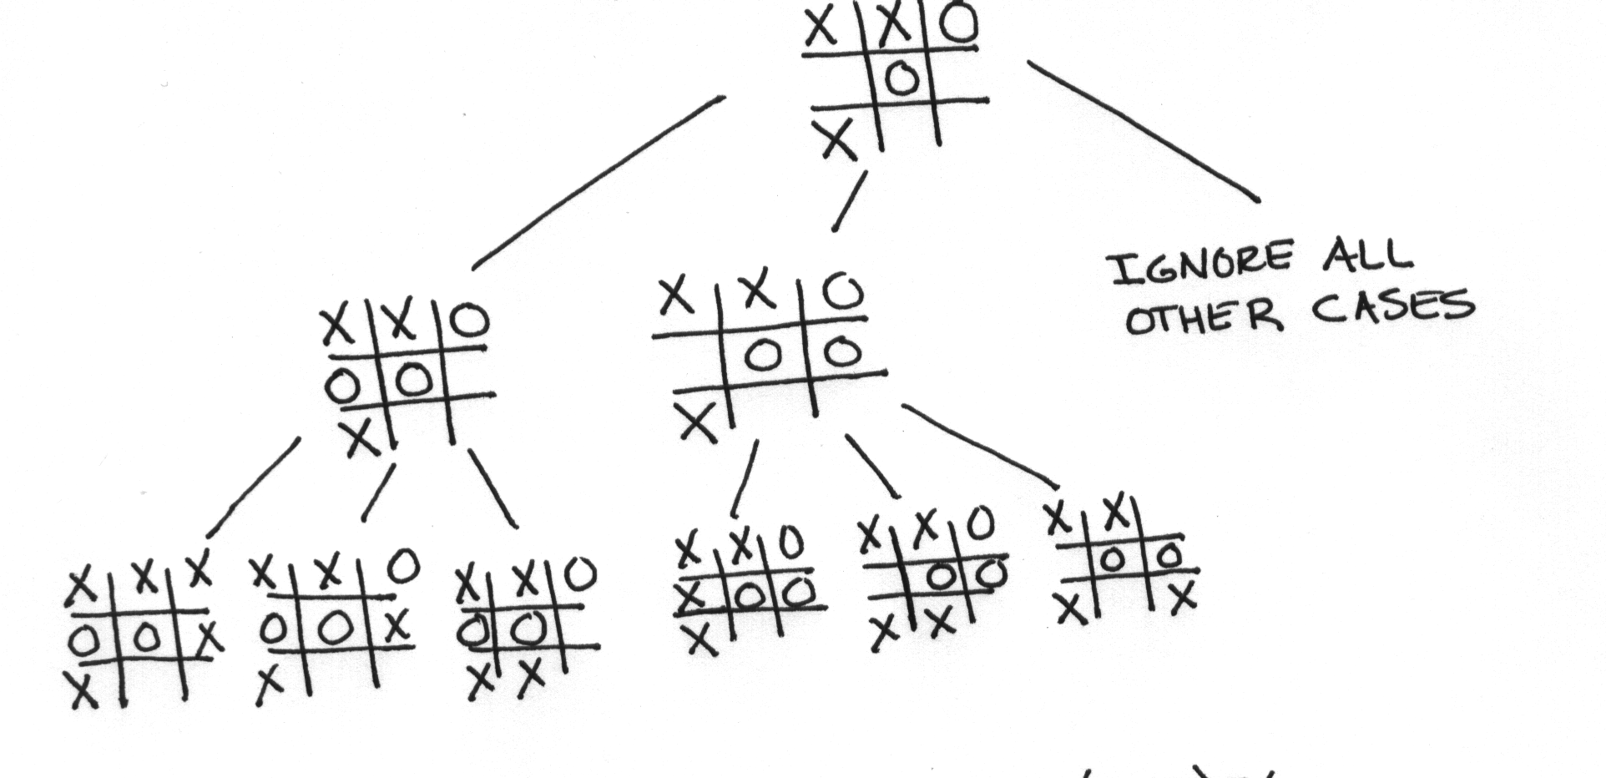
Formalization

Slide 106

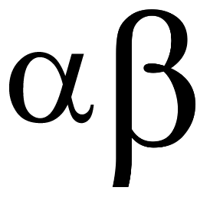
Algorithms

Slide 107

Imagining Search
40,000,000 years
3.00
1.25
Not the normal evolution image? Think about that!

Slide 108
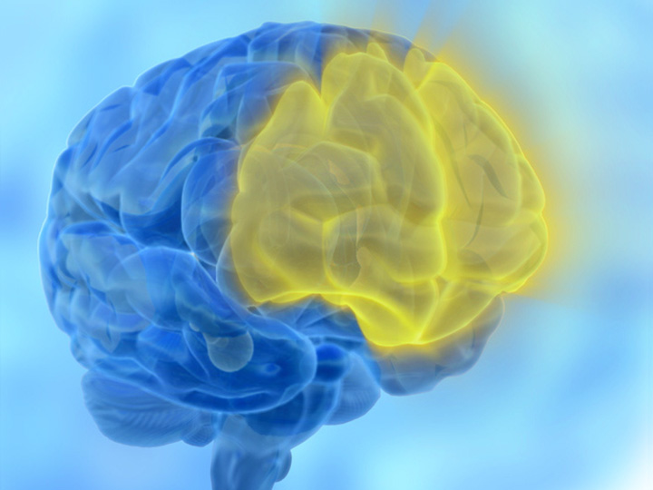

Slide 109

Many Modern Applications

Slide 110
Helicopter?

Slide 111
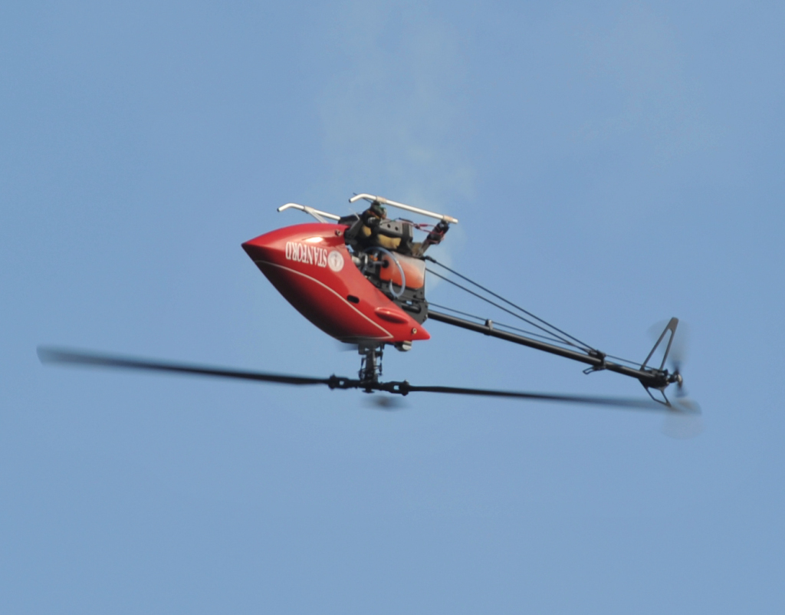

Slide 112
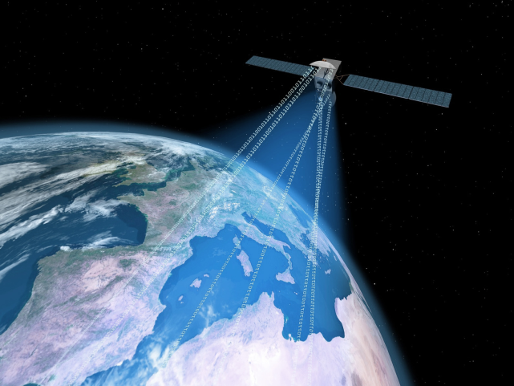
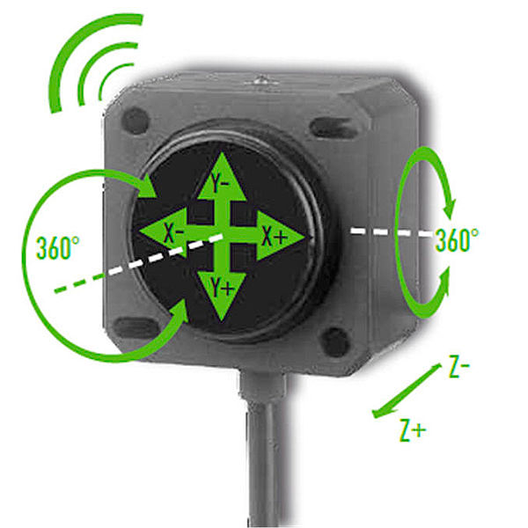
Knows its State

Slide 113
Discrete Actions
Latitudinal Pitch {forward, backwards}
Longitudinal Pitch {forward, backwards}
Tail Rotor {forward, backwards}
Main Rotor {forward, backwards}

Slide 114
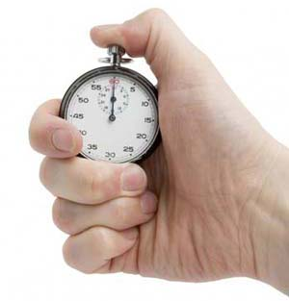
Discrete Time

Slide 115
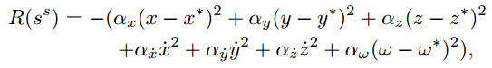
Known State Rewards
How far off the helicopter was from desired position and orientation

Slide 116
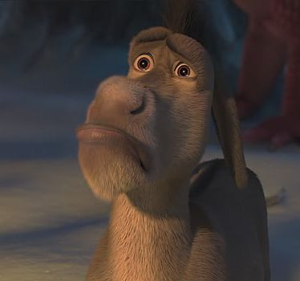
Continuous State…

Slide 117
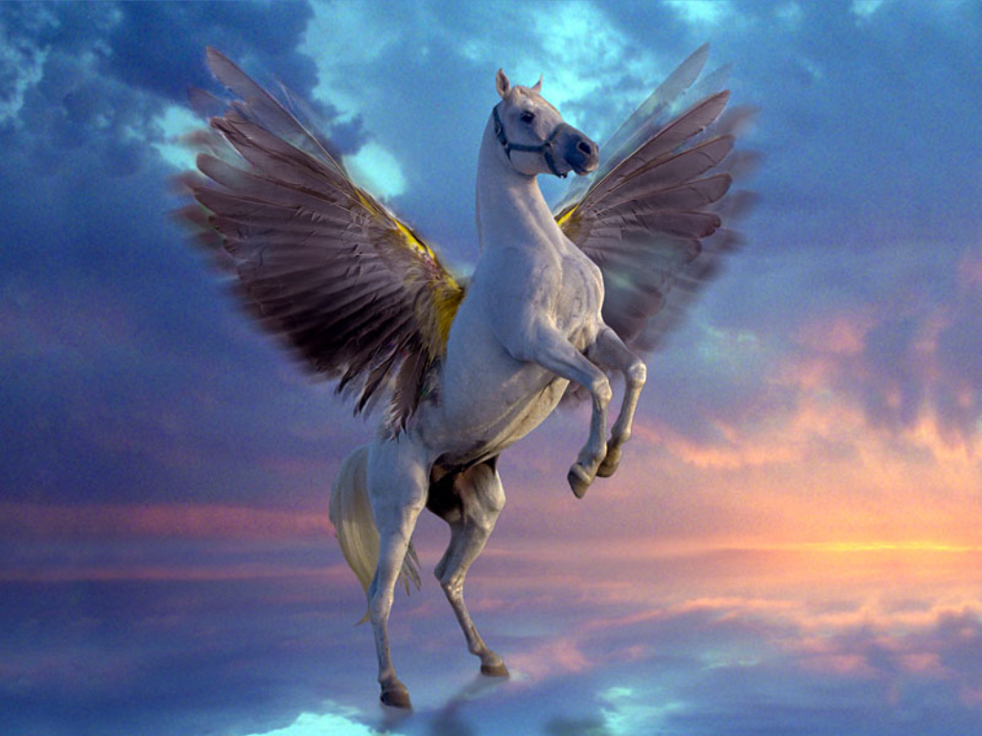
Use PEGASUS method

Slide 118
Dynamical Simulator
Stochastic to Discrete
Remove randomness by setting seed

Slide 119
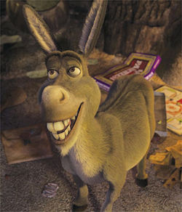
Discretized!

Slide 120
Transition Model?

Slide 121
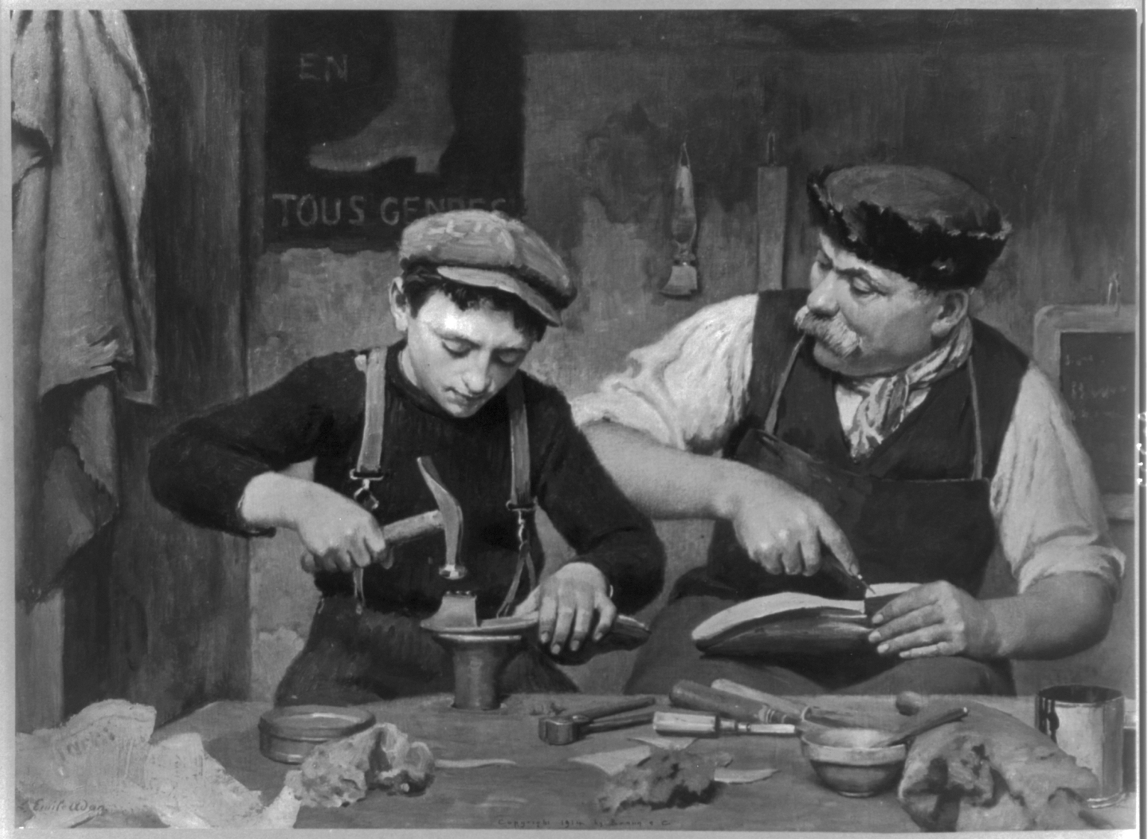
Apprenticeship

Slide 122
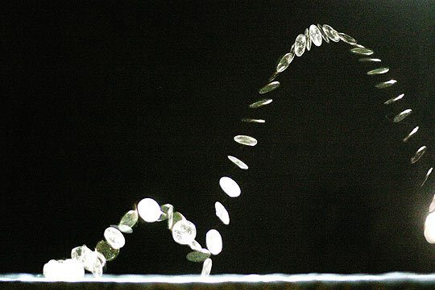
MDP Doesn’t Mean Flipping Coins

Slide 123

Ok: Simple Counting

Slide 124

Better: Variable Based Models

Slide 125
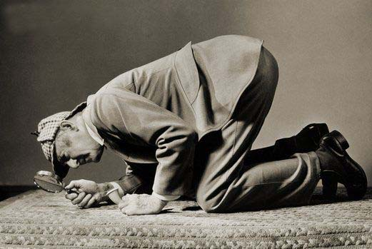
All together?

Slide 126

State Search is Powerful

Slide 127

The End

